Slide 1
Examination High Schools Fall 2019 Admissions
Office of Enrollment
November 29, 2018

Slide 2
Agenda
Welcome
Enrollment Updates
Examination High Schools
Important Dates
Assessment (In District & Out of District)
Application Components
NEW for 2018-2019 (Submittable, Supports, Spreading the word)
Submittable Tutorial

Slide 3
Enrollment Updates
Fall 2018 Count
Grade Caps
Enrollment Continues!/February Count & Fall 2019
Continue to enroll unless capped
Network Breakfast for 8th grade charters/HS principals

Slide 4
2019 Exam High Schools
Cass Technical High School
Martin Luther King Jr. Senior High School
New School at Marygrove
Renaissance High School
Southeastern High School

Slide 5
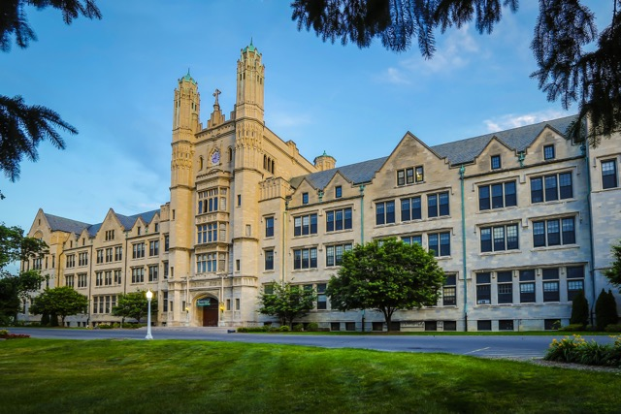
New school at Marygrove
Opening fall 2019 on the Marygrove College campus
9th grade only
Neighborhood enrollment preference
Social Justice and Engineering program

Slide 6
Important Dates
Dec. 1 Application goes live
Dec. 3-Jan. 18
Parent application support
Jan. 18 Application window closes
Feb. 4-8 Application scoring
Feb. 27 - 28 Application scoring
March 15 Students receive admission/
decline
Notices
March 15 Petition process begins for students who were denied
April 5 Petition application deadline
April 19 Students notified of petition status
April 27 – Level Up High School Expo
DPSCD 8th Graders Test Window: Jan. 14-25, 2019

Slide 7
The Assessment

Slide 8
Exam High School Assessment Administration
January 14 – January 25, 2019
Exam is worth 40% of the application
8th graders will be tested in school
Testing duration is roughly 2.5 hours
Only students who are on a high school diploma track are eligible to test
Accommodations must be provided to students whose IEPs require them

Slide 9
Assessment Information
Completion Rate Updates from District Assessment Staff:
Thursday January 17 – interim completion rate
Wednesday January 23 – interim completion rate
Friday January 25 – final completion rate
Student Population: All currently enrolled eighth grade students not eligible for Mi-Access

Slide 10
Next Steps for Schools
Assessment Coordinator Training (asynchronous webcast) posted to Assessment SharePoint Site by December 12
Technology Requirements
Process for requesting paper/pencil accommodations
Assessment Timing
Student Login Information and Procedures
Proctor Expectations

Slide 11
Out-of-District Testing
Proctors needed
Workshop pay offered
3-hour or 6-hour shifts
Earhart and Brenda Scott locations
Saturday January 26
Saturday February 2
Saturday February 9
(If needed snow day)

Slide 12
The Application

Slide 13
What counselors should know
Taking the test is not enough. Every student must submit an application to be considered for admission.
Students who miss the January testing will be allowed to take the test on one of the out-of-district days in February or July.
Application components:
Student Letter of Interest (Formal letter)
Grade Point Average
Letter of Recommendation (New Format)

Slide 14
Application Score Values
Criteria | Possible Points
Examination Score | 40
Grade Point Average | 30
Writing Sample (Letter of Interest) | 20
Letter of Recommendation | 10
Total Points | 100
DPSCD Student | +10
Marygrove Boundary Resident – Primary Catchment | +10
Marygrove Boundary Resident – Secondary Catchment | +5

Slide 15
New Application Management System
Instant and streamlined communications to improve applicant and administrator experiences
Shared information across different categories of users – Counselors, high schools, Enrollment
All steps handled in one location: Student Applications, Application Review Process, Appeals and Pre-Enrollment
Ability to save and return to applications in progress

Slide 16
To apply: Detroitk12.org/examschools

Slide 17
Supports for Families
Enrollment will offer a robust schedule of training sessions to assist schools and parents with student applications.
Parent workshops will take place throughout the city, with ASL, Spanish and Arabic interpreters on select dates.
Parents may bring documents that need to be scanned/uploaded to their application.

Slide 18
Supports for Families
Parents can drop in or call Enrollment for assistance: (313) 873-6345.
An online tutorial will be available at: detroitk12.org/examschools
In collaboration with FACE, parent leaders will be trained to assist parents.
EHS Assessment Study Guide

Slide 19
Supports for Families
Schools will be equipped to support families with their applications. Consider the following opportunities:
Office hours with the 8th grade counselor
PAL-led workshops for parents Announce parent workshop dates in your school newsletter
Consider offering defined times, such as right after drop off or right before pickup
Get creative!

Slide 20
Spreading the Word
Print media
Electronic advertising
Radio
Social Media
Robo Calls
Flyers
Level Up Breakfast
Kicker Cards

Slide 21
Submittable Tutorial

Slide 22
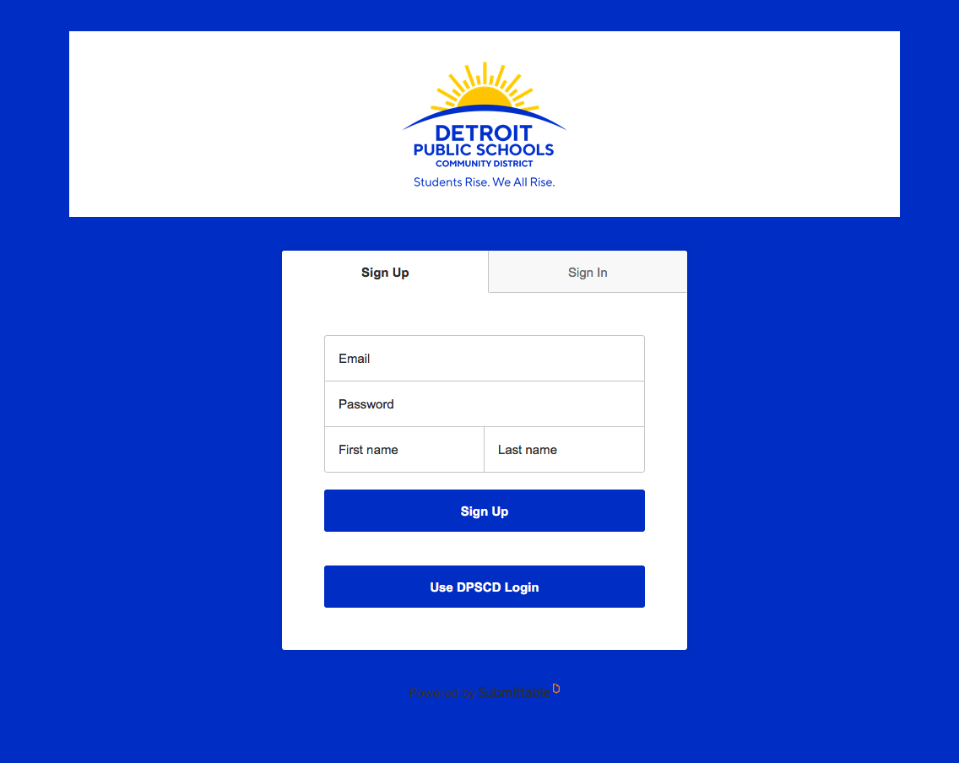
Setting Up a Submittable Account
Sign Up
Parents and students wishing to apply for admission to exam high schools should click this option.
Use DPSCD Login
Employees conducting school business regarding exam applications (scoring, reviewing application status, etc.) should use this option.

Slide 23
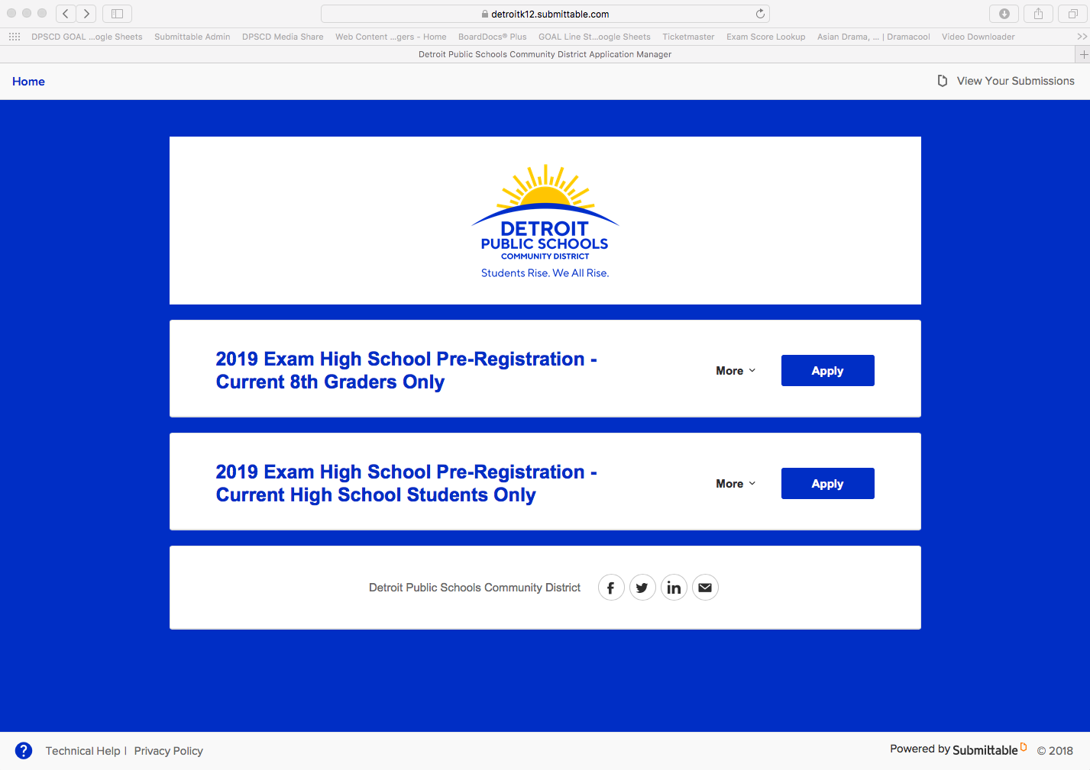
Selecting an Application
Two application options:
Current 8th Graders
Current high school students
Students must select the appropriate choice

Slide 24
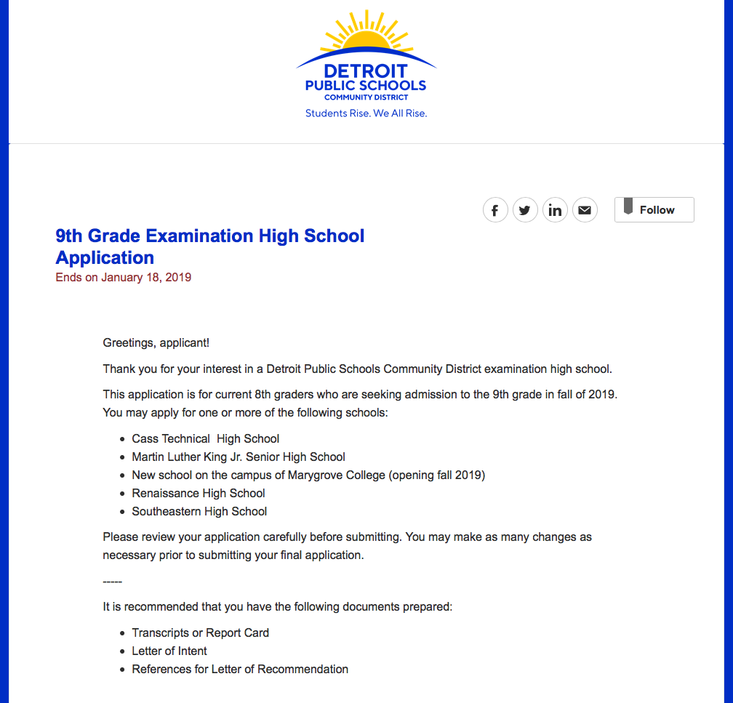
Logging in
Welcome page
First-time users will create an account
Returning users will sign in
Note: Students may save applications in progress and return to them as needed.

Slide 25
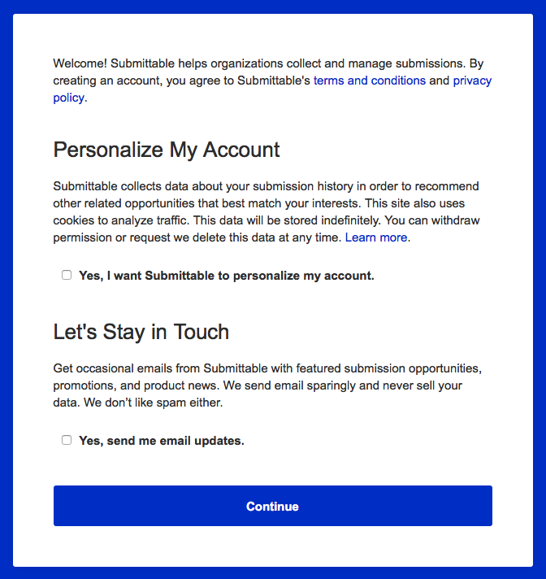
Terms and Conditions
Read through the terms and conditions for use of the Submittable website.
Check yes in the below boxes if applicable. If not applicable, leave boxes unchecked.
This does not affect your ability to receive exam application notifications.
Click “Continue”

Slide 26
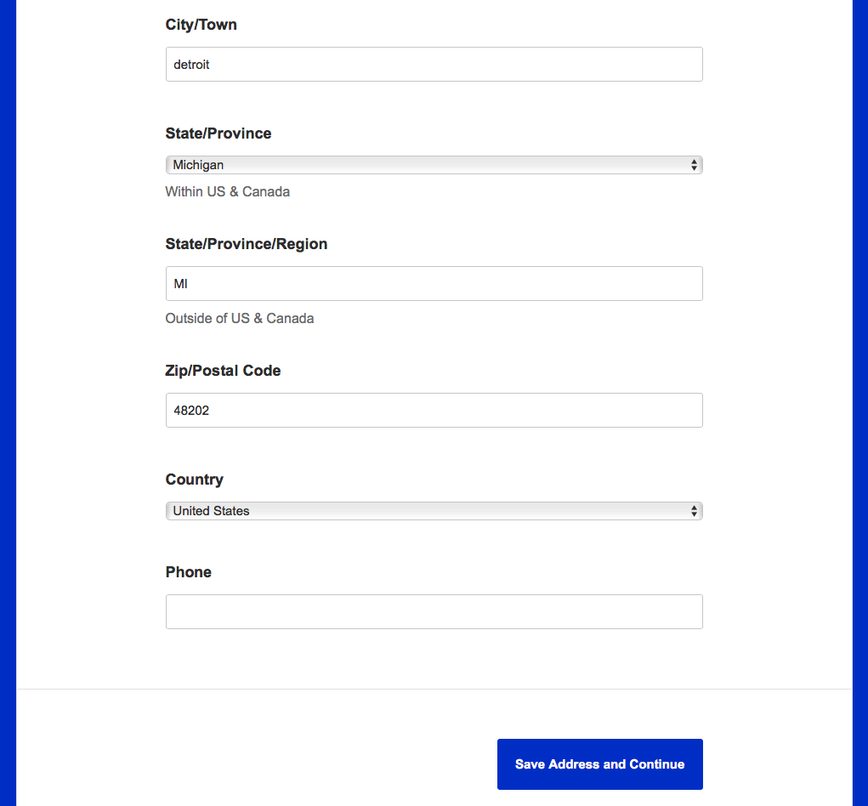
Contact information
Student enters all requested identification and contact information.

Slide 27
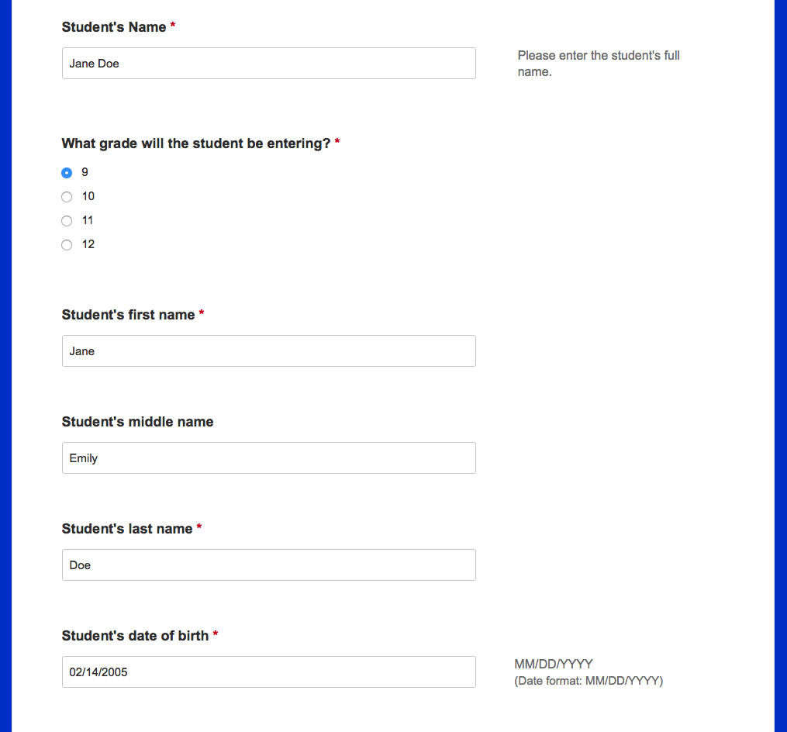
Student Information
Complete the student’s information
There are two separate applications:
Current 8th graders
Current 9th and 10th graders

Slide 28
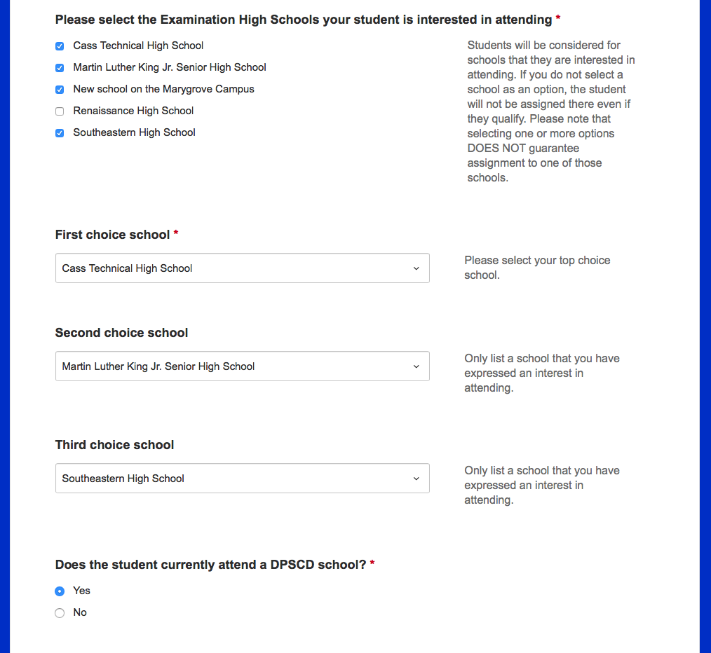
Exam school selection and ranking
Students may express interest in one or more schools
Applicants will not be admitted to a school they did not express interest in.
Applicants should keep all viable options open
Applicant enters their current school

Slide 29
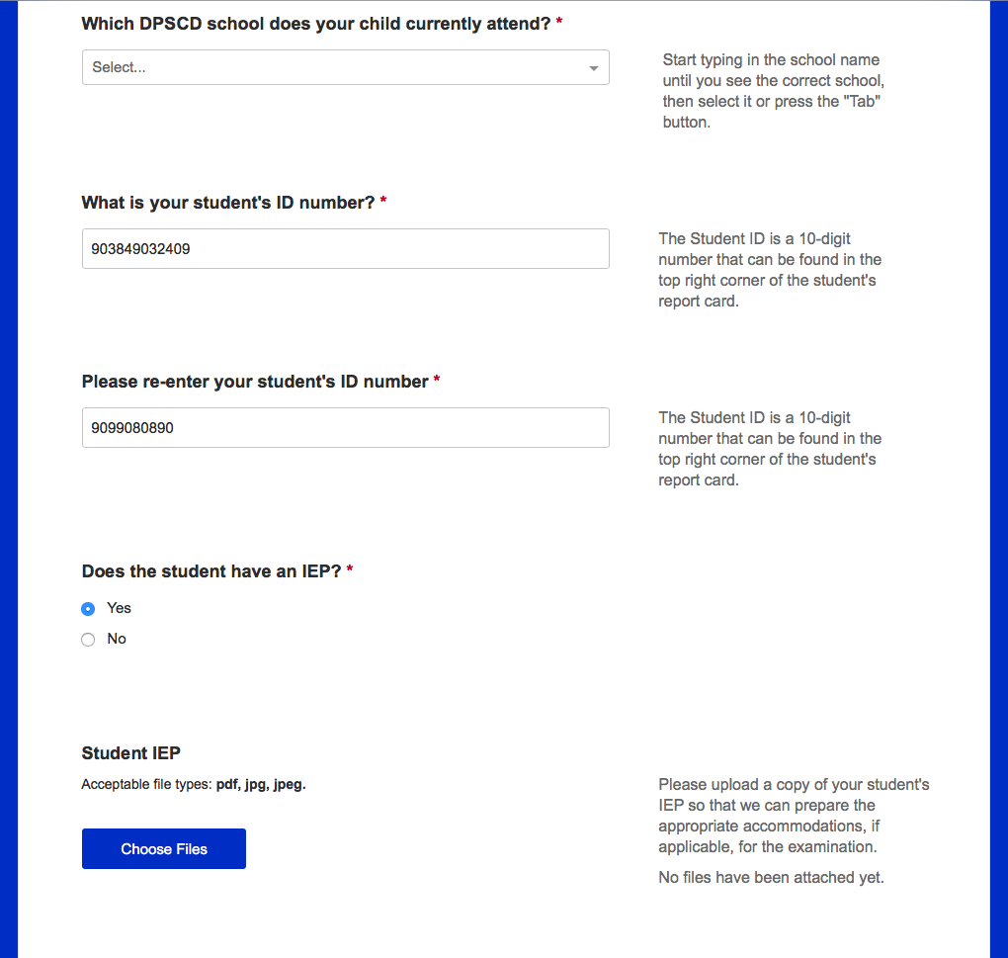
DPSCD Students
School selection is a dropdown menu
Applicants may find their school in one of two ways:
Select from the list provided
Start typing the name, then hitting “tab.”

Slide 30
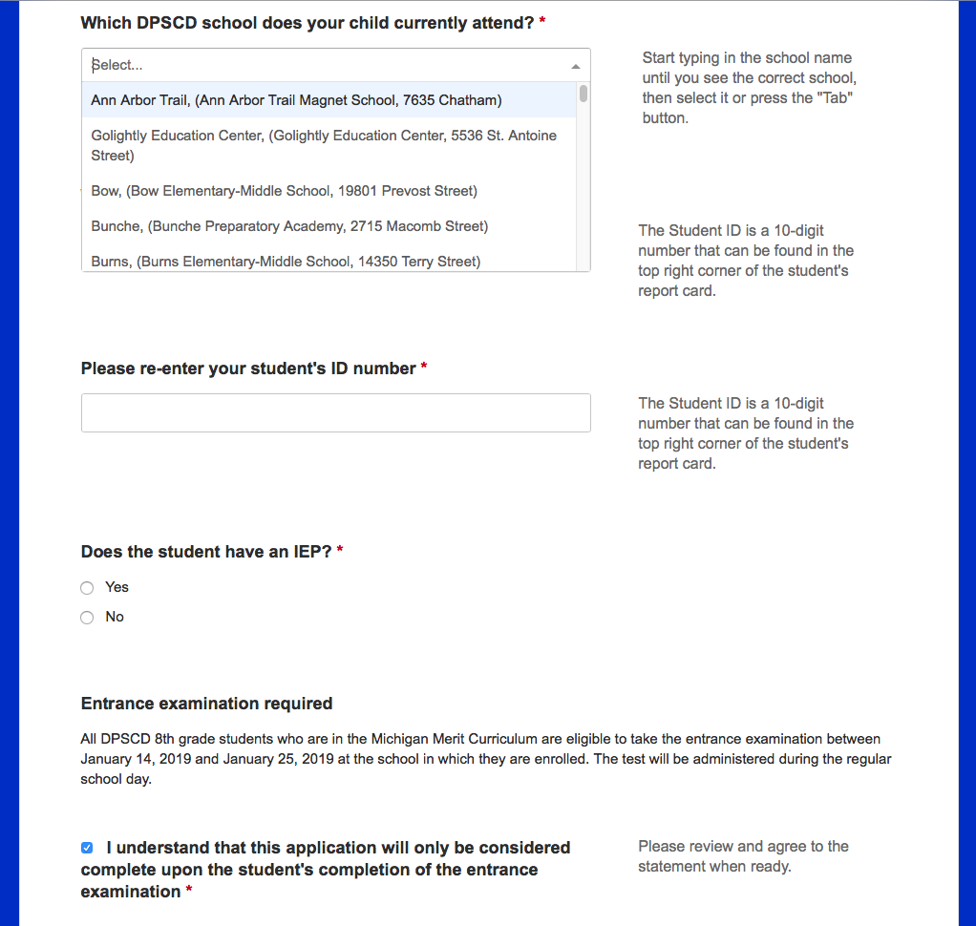
DPSCD Students
Dropdown Menu

Slide 31
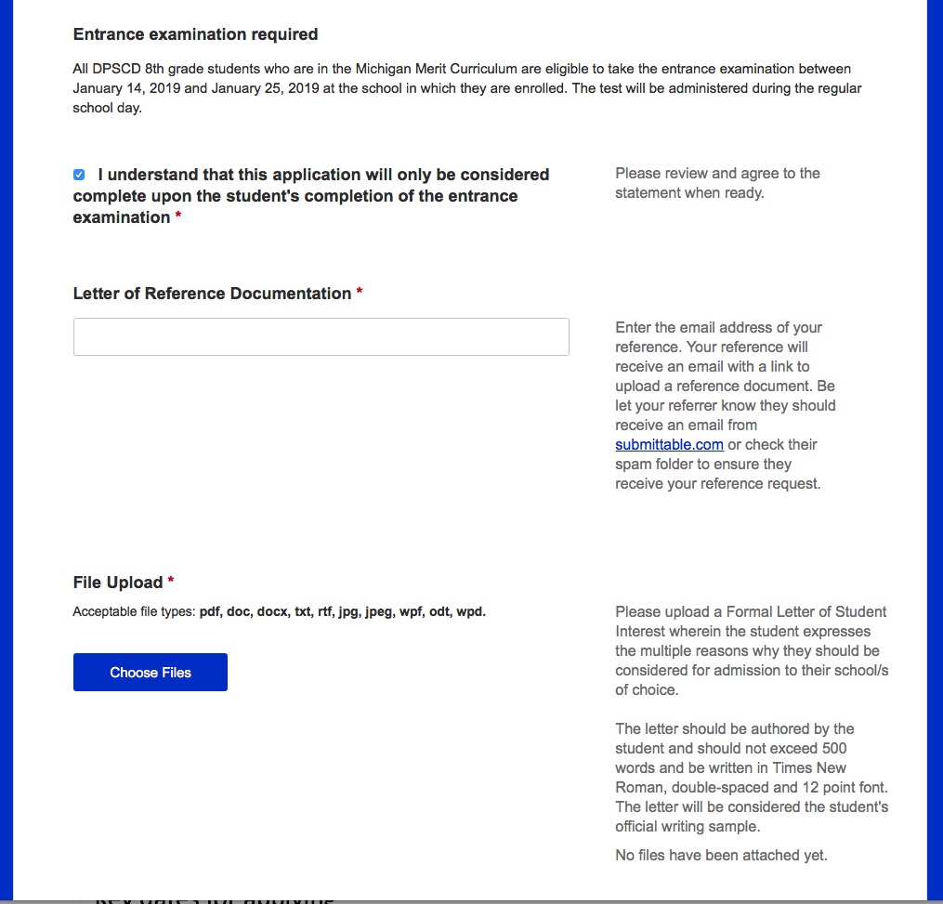
File Uploads
Notice of exam requirement
Letter of Reference
Students are required to provide an email address for their reference
Student’s letter must be uploaded

Slide 32
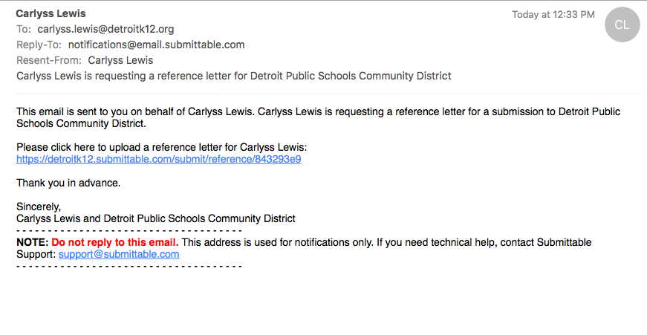
Reference Request
References will receive an email instructing them to upload the reference letter.
References will be a form with check boxes.
No written letters.

Slide 33
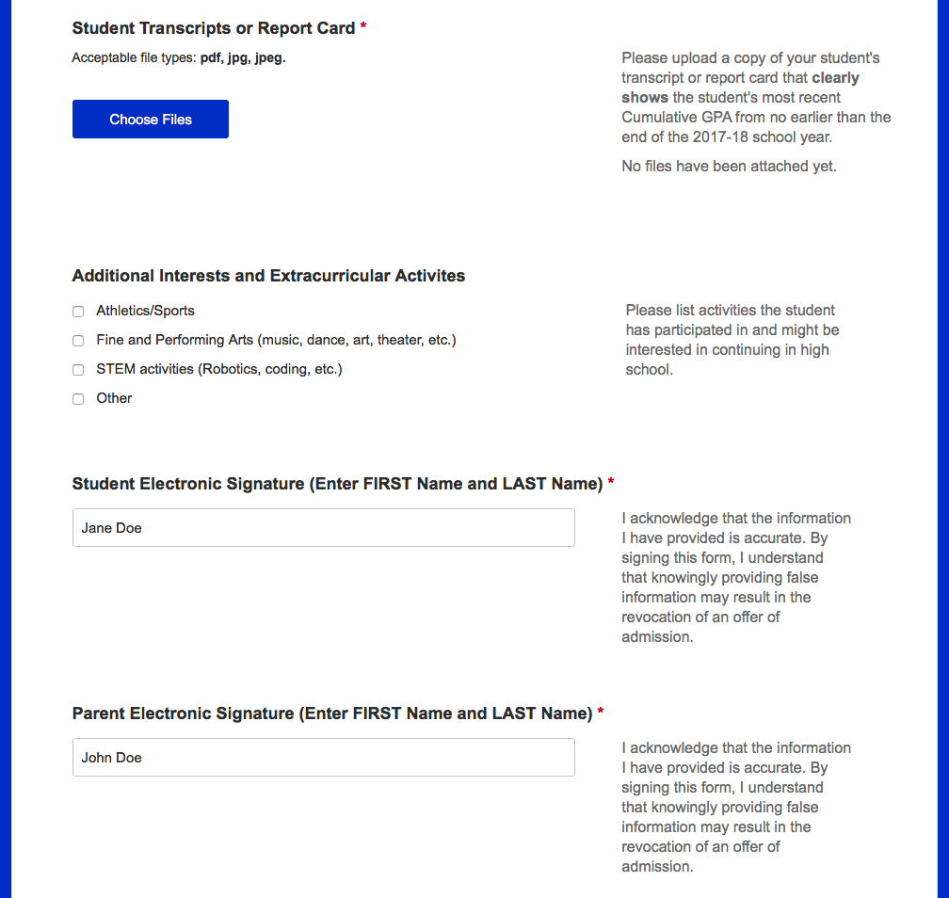
Uploads, Interests and Electronic Signatures
Student and parent/guardian are expected to electronically sign
Acknowledgement that their application is truthful
Admission may be rescinded if the application is not truthful

Slide 34
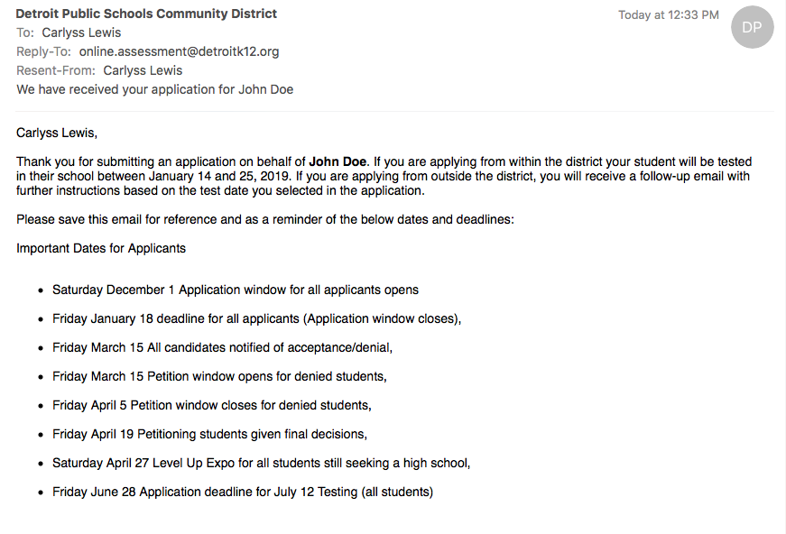
All successful applicants will get a confirmation email.

